Slide 1
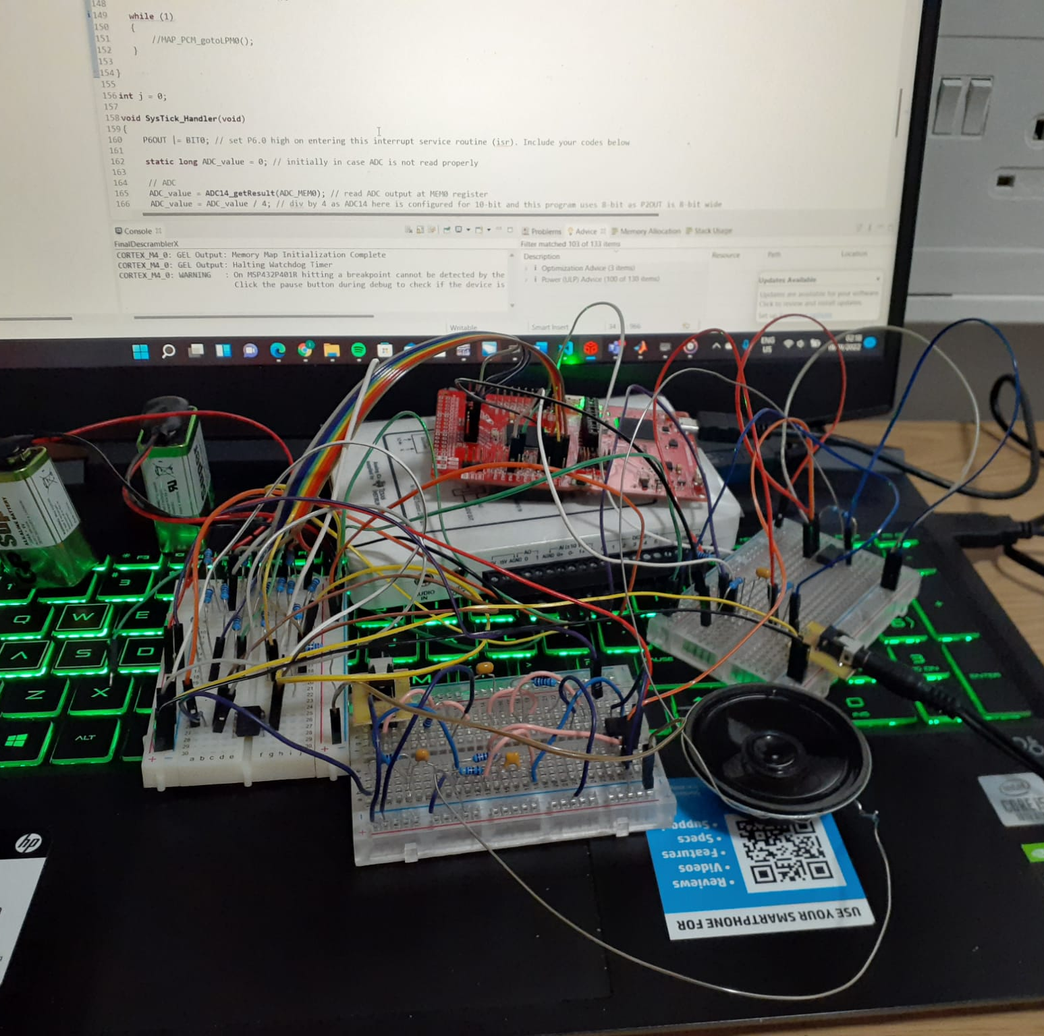
Scenario x
Team: Iason Chaimalas, Arlend Osmani, Joshua Tan, Mingyu Jia

Slide 2
Main objectives
Work out how the scrambling is done
Design and build a digital real-time audio descrambler to work out what the secret message is.

Slide 3
General block diagram to descramble message
MSP432
Scrambled message
Potentiometer biasing 0-1.2V,
ADC conversion
Removal of the 8khz signal
Sin wave modulation
Speaker output
Original message
Filtering the double sideband
DAC conversion

Slide 4
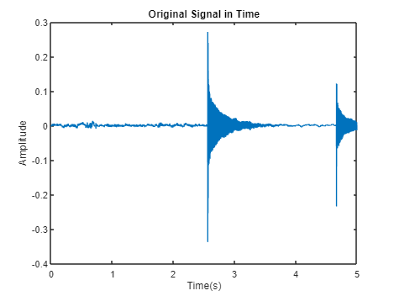
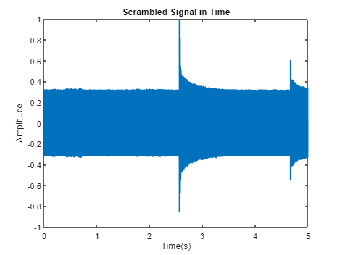
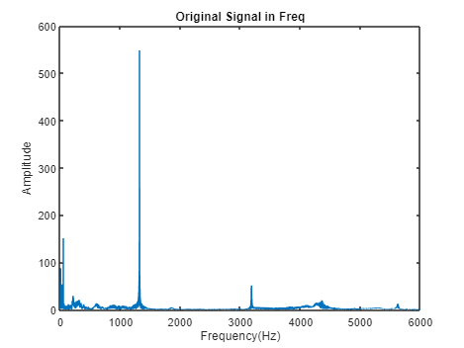
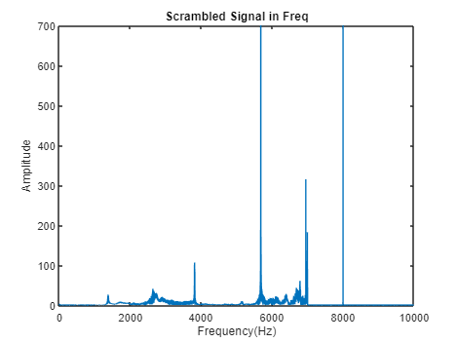
How the Message was Scrambled
The message was flipped in the frequency spectrum about the point 3.5kHz.
Furthermore, an 8kHz sine wave was added to the signal.

Slide 5
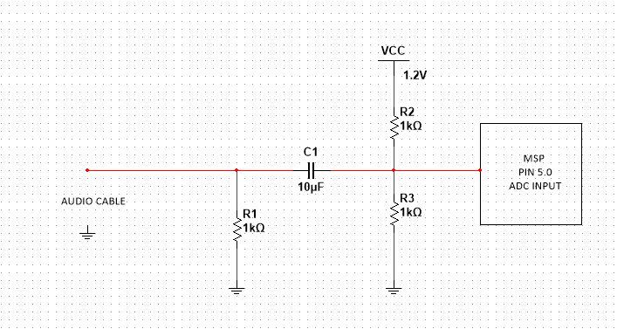
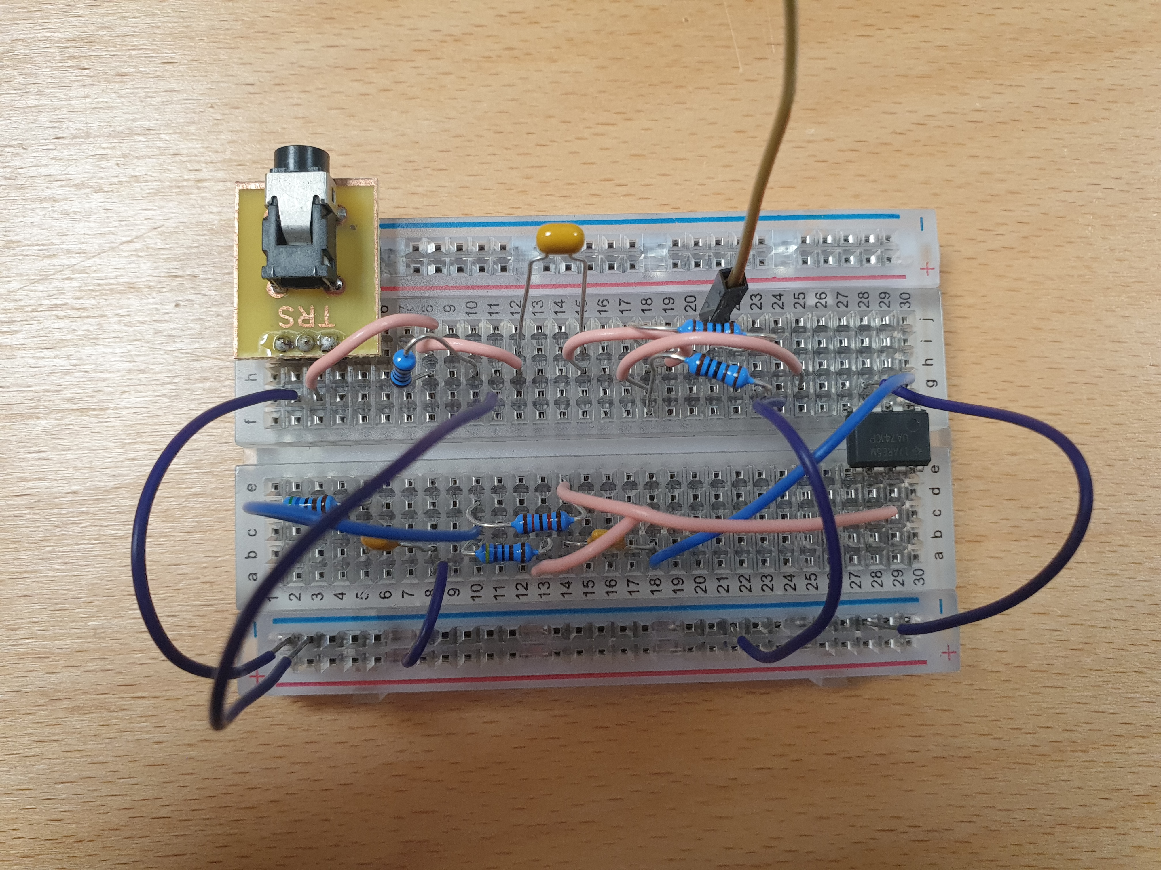
Potentiometer Biasing Circuit
How it works:
Removes any previous DC offset with C1 capacitor
It is a bias circuit that is centered at 0.6V mean value (added bias)
Scales audio input to 0 – 1.2V peak-to-peak
The MSP input pins can only read positive voltages; therefore, this circuit is used to shift the signal 0.6V upwards in time domain

Slide 6
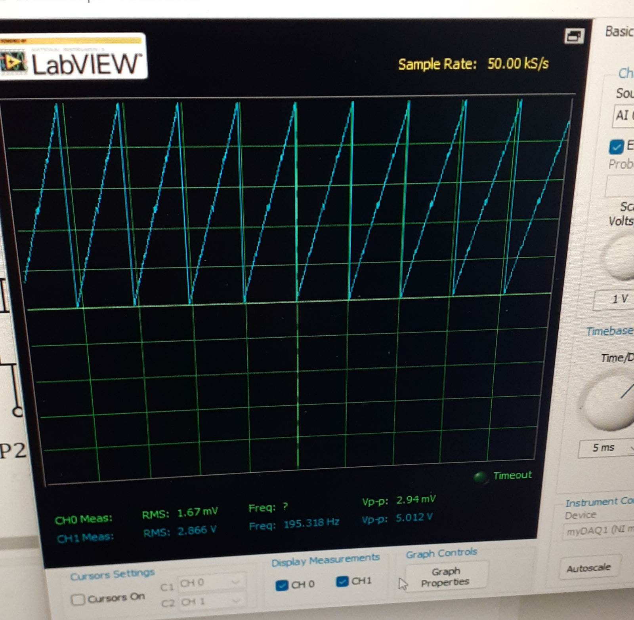
ADC
PIN 5.0 of the MSP Board is the ADC
The audio input comes from the audio jack and goes through the potentiometer biasing circuit and into the ADC.
The ADC has a set reference voltage of 1.2V. This means that the ADC can read voltages from the input pins between GND and 1.2V.
For accuracy, the ADC is 10-bit 0 -1023
This is divided by 4 to become 8-bits 0-255
This is due to pins 2.0 - 2.7 only being 8-bits wide, and the signal is outputted at these pins.
Ramp output testing ADC + DAC

Slide 7
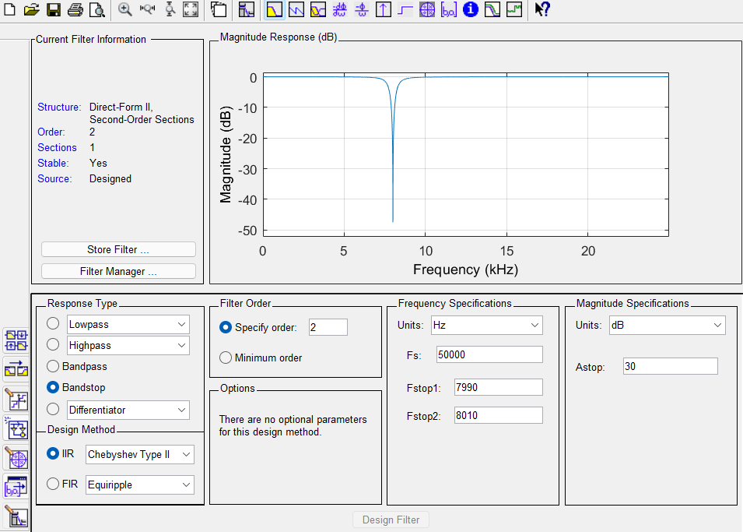
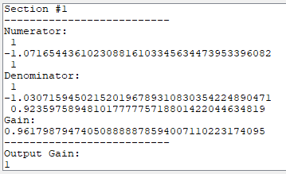
Bandstop Filter
remove the 8 kHz tone.
Infinite Impulse Response (IIR) Type 2 2nd-Order Chebyshev Digital Filter
y_{n} – 1.03y_{n-1} + 0.92y_{n-2} = 0.96(x_{n} – 1.07x_{n-1} + x_{n-2}) -> y_{n} = 1.03y_{n-1} - 0.92y_{n-2} + 0.96(x_{n} – 1.07x_{n-1} + x_{n-2})

Slide 8
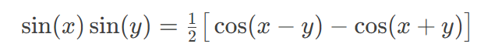
Sine Wave
WHY Modulate by Sine?
-- Half-power sidebands about y frequency
Scrambled Audio has flipped the original in 0Hz – 7kHz
Multiply by sin(2π7000) to flip scrambled audio about 7kHz with flipped sideband in 0Hz-7kHz and high-frequency sideband.
0Hz-7kHz is double-flipped so back to original audio.
High-frequency sideband filtered by anti-aliasing filter.

Slide 9
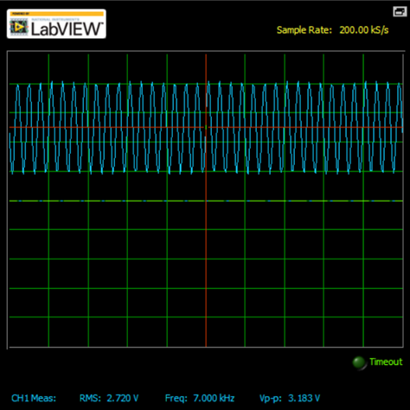
Sine Wave
HOW to make smooth Sine
Master Clock (MCLK) = 48kHz and SysTick ISR runs every 960 CLK cycles
--> SysTick runs at 50kHz sample rate
Sine multiplies the Bandstop output in SysTick so the sine must be sampled at 50kHz
Problem: 7kHz sine frequency does not divide into 50kHz sample frequency
Solution: Using sine and cosine at A=2kHz and B=5kHz as A and B divide into 50kHz!
sin(A+B) = sin(7kHz) = sin(A)cos(B) + cos(A)sin(B)

Slide 10
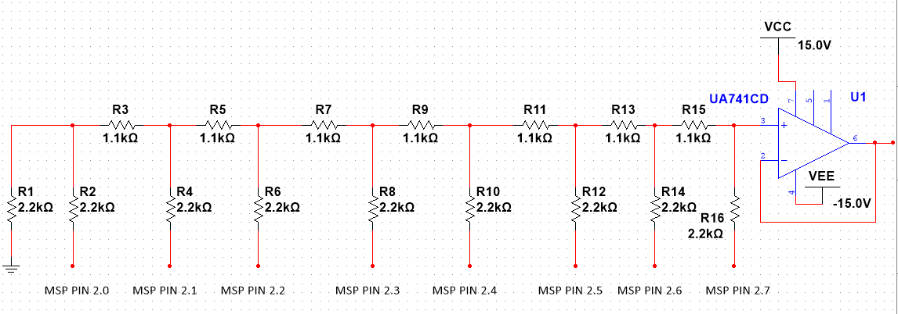
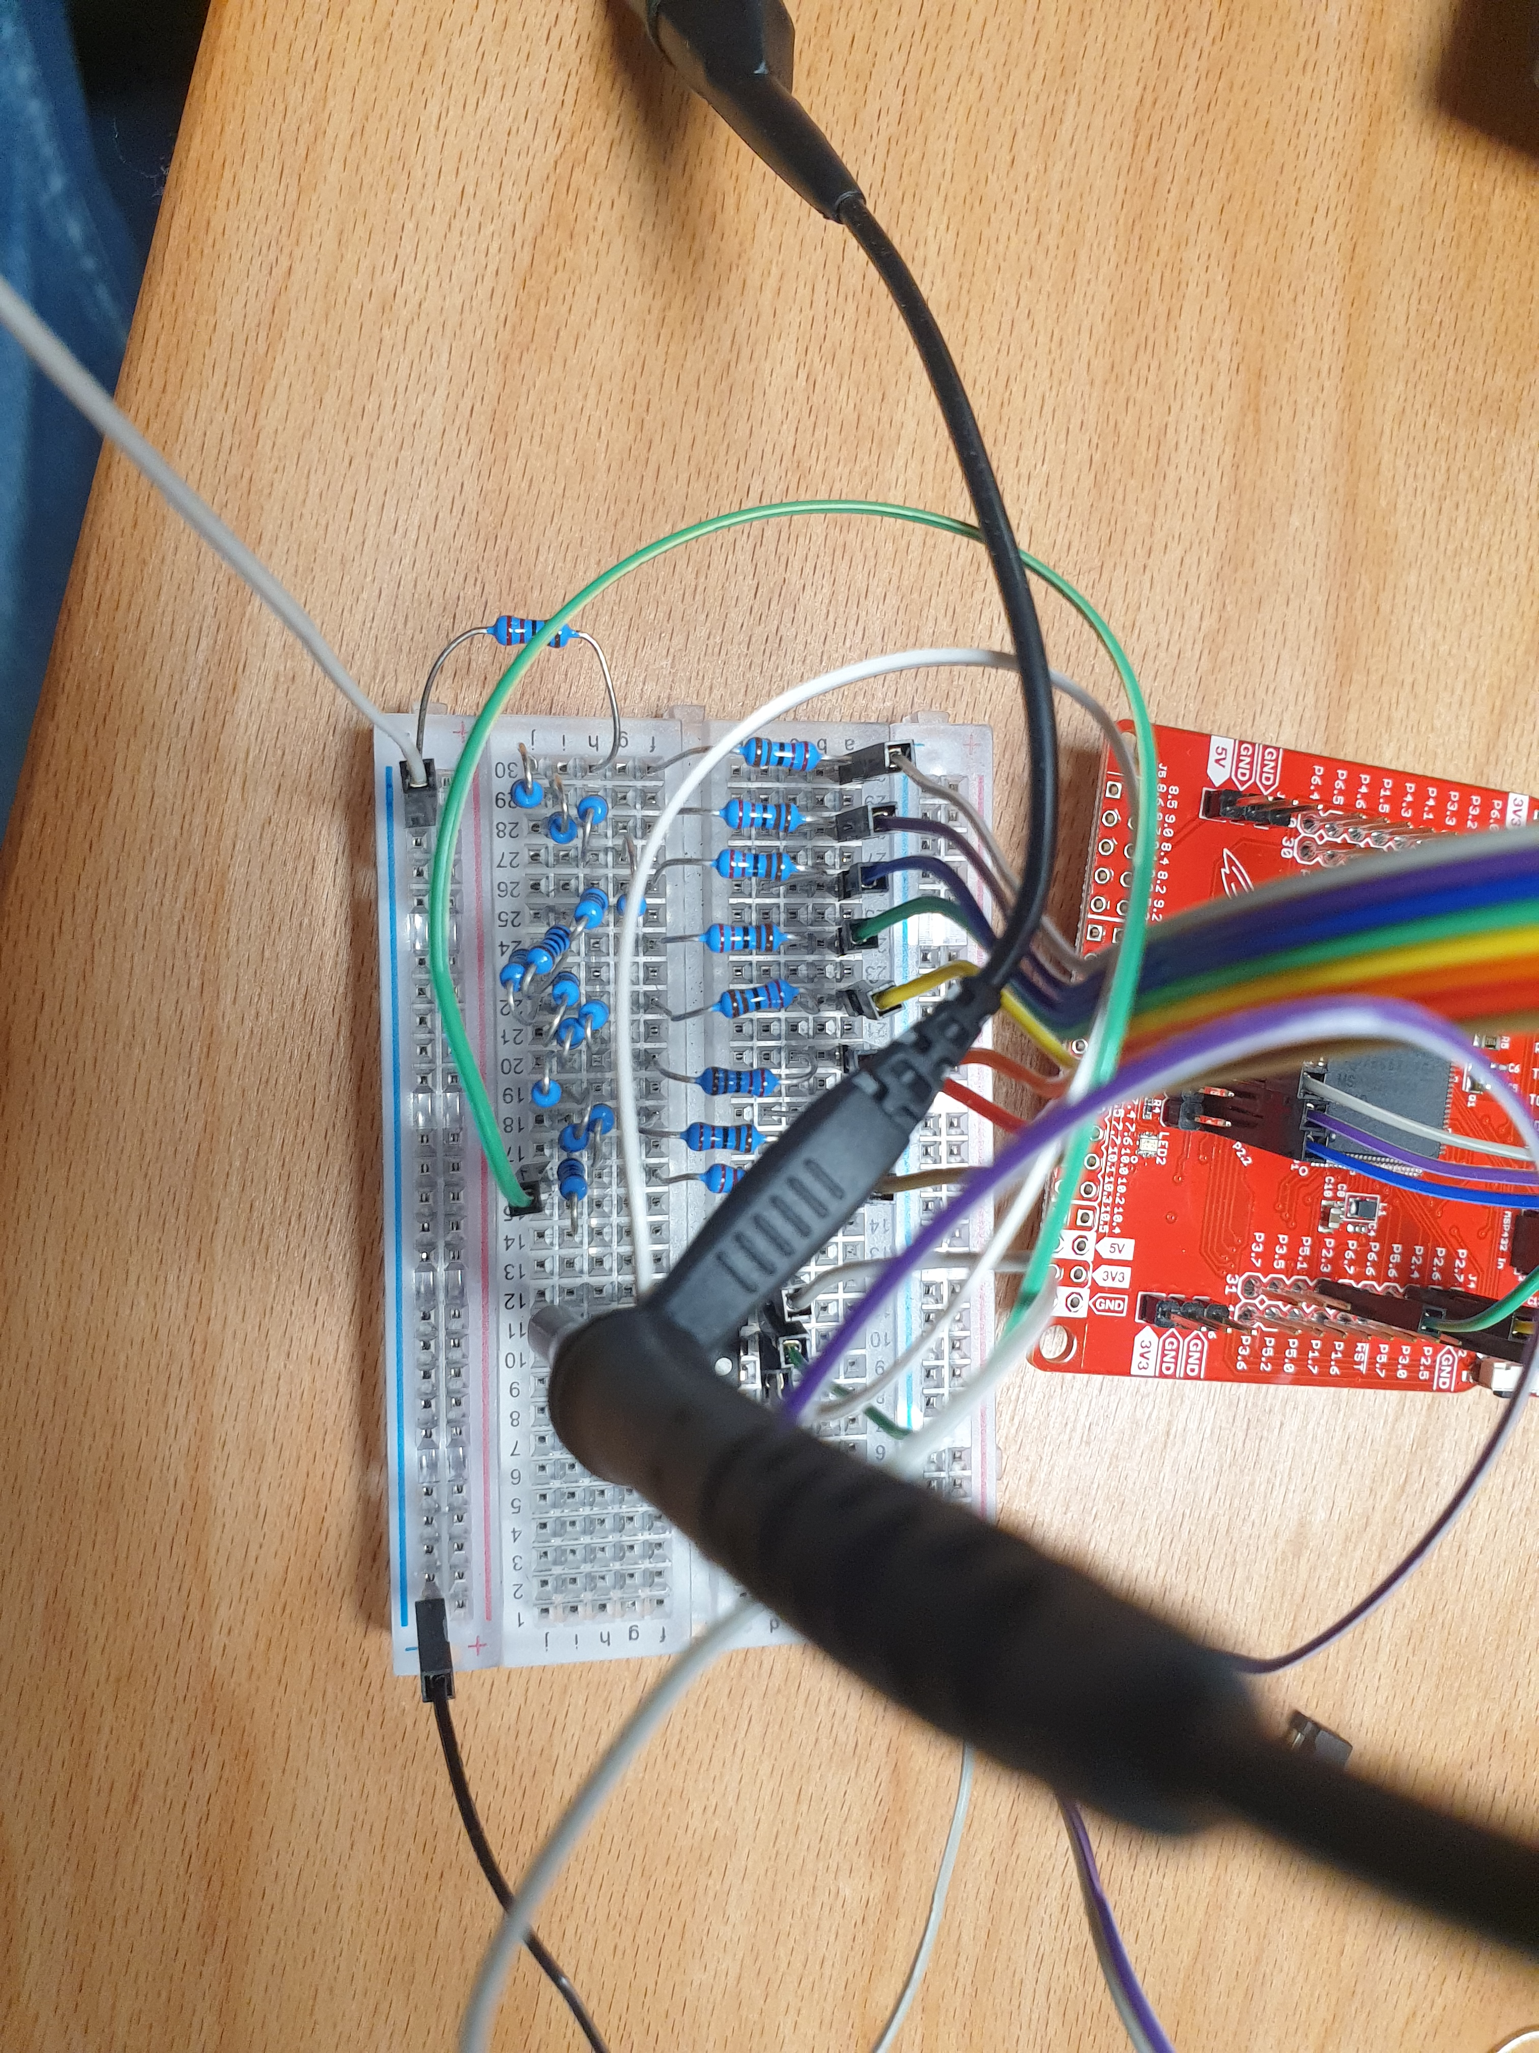
Digital-to-Analogue Converter (DAC) R – 2R Ladder:
9.0V
-9.0V
How it works:
The 8-bit digital signal from the MSP output is converted into an analogue signal
Input voltages are applied to the R – 2R Ladder at various points, the MSP Pins.
More input points results in better resolution
All the input voltages combine at the end of the R – 2R Ladder
This drives the amplifier input

Slide 11
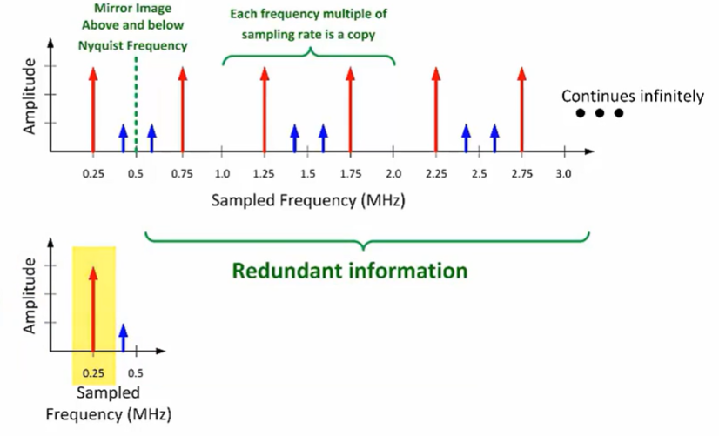
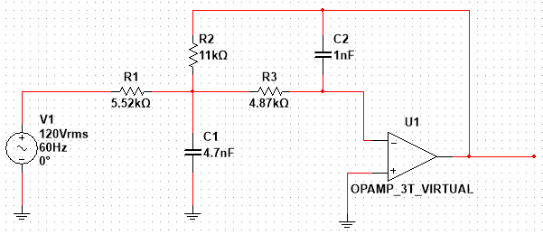
ALIASING
Aliasing is also commonly called folding back or mirroring of the input signal.
The anti-aliasing filter is essentially a low pass filter.
What should be displayed
Figure a.

Slide 12
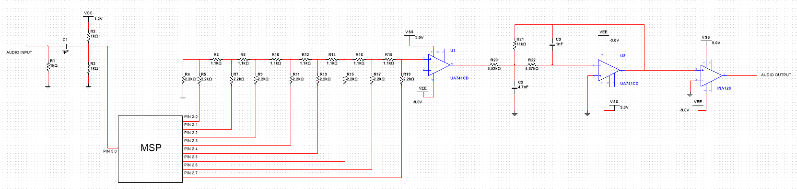
Full Schematic
Potentiometer Biasing
DAC
Anti-Aliasing Filter
MSP:
- ADC
- Band-stop Filter
- Multiply by Sinewave
Buffer
INA128 Amplifier

Slide 13
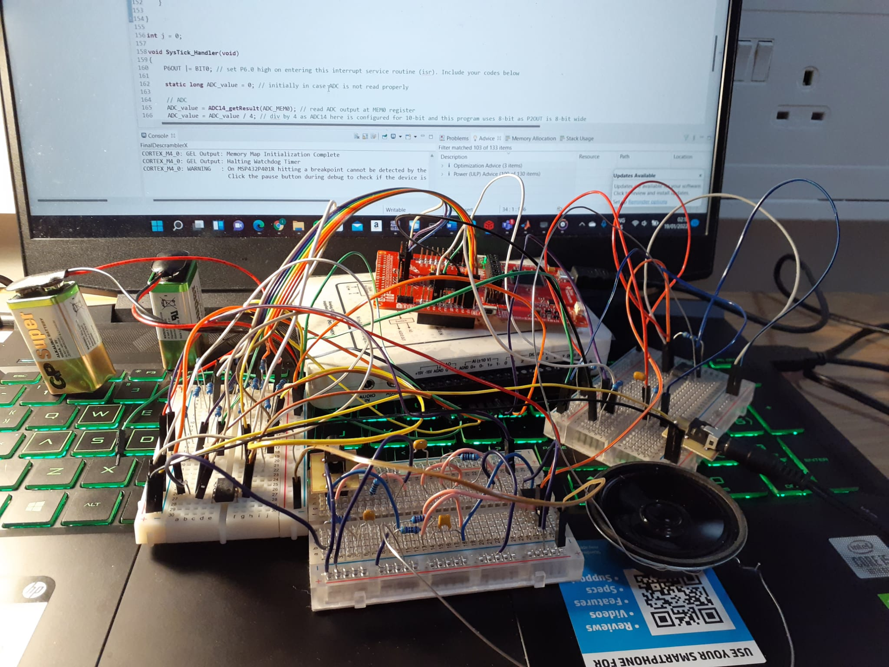
Full Built Circuit

Slide 14
Demonstration

Slide 15
References
[1] Figure a: Texas Instruments. (2018, February 20). TI Preciyoutubesion Labs - ADCs: Aliasing and Anti-aliasing Filters [Video]. YouTube. https://www..com/watch?v=T4M6xN-LMWw

